Slide 1

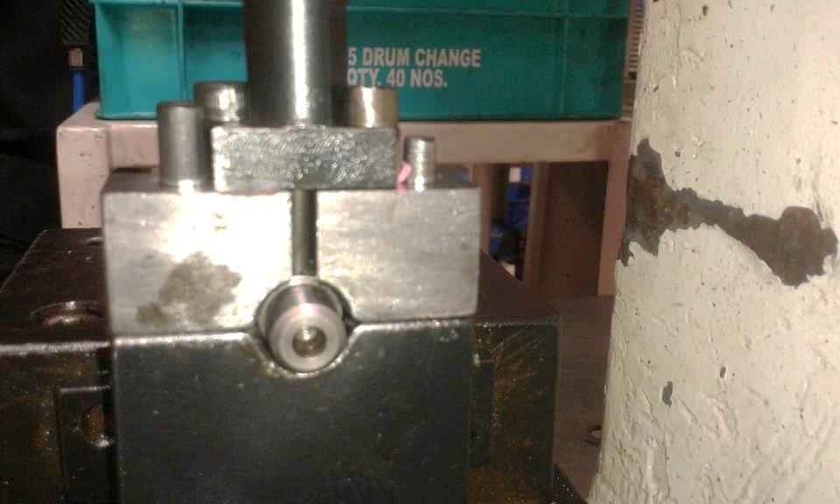
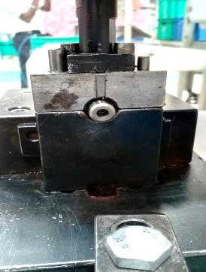
P15
TPM CIRCLE NO :- 01
ACTIVITY
KK
QM
PM
JH
SHE
OT
DM
E&T
KAIZEN IDEA SHEET
TPM CIRCLE NAME: Achiever
LOSS NO. / STEP
DEPT :- MACHINE SHOP
RESULT AREA
P
Q
A
C
D
S
M
B
CELL:-
CELL NAME:-
MACHINE / STAGE :-
OPERATION :-
KAIZEN THEME :
IDEA :- Provide guide bush
PROBLEM PRESENT STATUS :-more rejection generate during pressing pin tilt
COUNTERMEASURE : Guide bush is provide to pressing tool .
BENCHMARK
TARGET
KAIZEN START
TDC
Guide bush, for dowel spring pin
KAIZEN FINISH
TEAM MEMBERS :, Umesh
Pimple, Ganesh Kharmale, D.Y. Pawar
Dowel spring pin, no guide bush.
BENEFITS :-
Before
After
KAIZEN SUSTENANCE
RESULT :-
WHAT TO DO:- Check point added in Sustenance audit check sheet.
HOW TO DO:- Check visually.
FREQUENCY :- Daily
WHY - WHY ANALYSIS :-generate rejection
Why1 :- Pin tilt during pressing
Why2 :-No bush is available
Why3 :-
Why4 :-
SCOPE & PLAN FOR HORIZONTAL DEPLOYMENT
Sr No | CELL | TDC | RESP. | STATUS
1 | Oil Pump | 20.03.17 | Ganesh Kharmale | In process
2
ROOT CAUSE : No guide bush available to pressing tool .
No guide bush available to pressing tool to avoid pin tilting during pressing.
REGISTRATION NO. & DATE : 07.02.2017
REGISTERED BY :- Sachin Kadnar
MANAGER’S SIGN :- Sandeep Patil

